Slide 1


Exploring Test Automation:
A Comparative Analysis of Generative AI and Traditional ML Approaches

Slide 2


Γειά σας!
About me
Based in Athens, Greece
I love working in all things that touch Product and Engineering
Grafana Champion
I love hiking and fishing
Contact
Email: gpapadakis@gwi.com
Ioannis Papadakis
Director QA, GWI

Slide 3


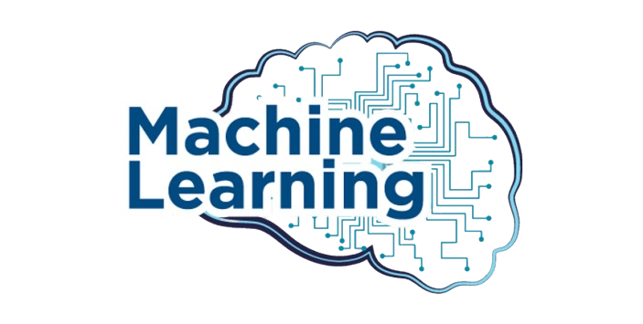

Agenda
1
Generative AI in Software Testing
2
Practical Examples
3
Comparative Analysis with ML
4
Learnings / Q&A
Notes:
Practical Examples:
Github Copilot vs ChatGPT
Generating real time test data
Self Healing Tests with Selenium and ML

Slide 4
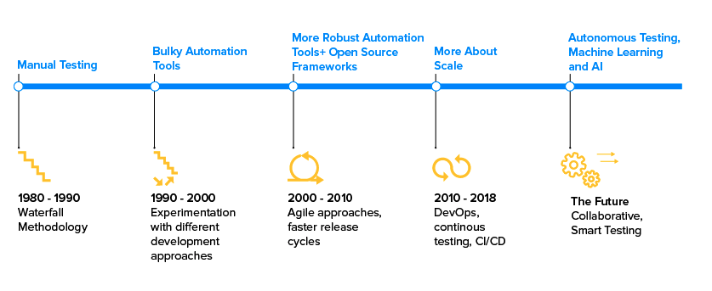
Evolution of Quality Management Methods
Notes:
If we sit to analyze the software development journey ever since agile came into the picture, we will find that the ways of software delivery have completely changed.
In the present situation, testing needs assistance for accelerating delivery. The role of artificial intelligence to improve quality control can help us reach there. There is a need for change in the way quality assurance operates in organizations. Mainly, there are two driving forces to continue quality assurance service – one is the agility in the manner testing is done (i.e. constant quality assurance) and the second is the quicker time to market. For QA testers to stay up with the agile method of development, traditional test automation is not sufficient, thus making AI in test automation unavoidable.
The Quality Assurance strategies have changed in today’s time. The ones that existed back in the 1980s have crossed several strides to keep up with the changing requirements of the software development and delivery approaches and cycle. The present case, popularized as continuous testing, is dominated by the Agile and CI/CD approach. Even after being denoted as one of the most developed stages of software testing using artificial intelligence, continuous testing brings some key challenges in Quality Assurance workflow processes:
Siloed automation
Absence of end to end requirements visibility
The high volume of test
To solve these issues, the industry must move to autonomous testing which ensures a zero-touch QA.

Slide 5
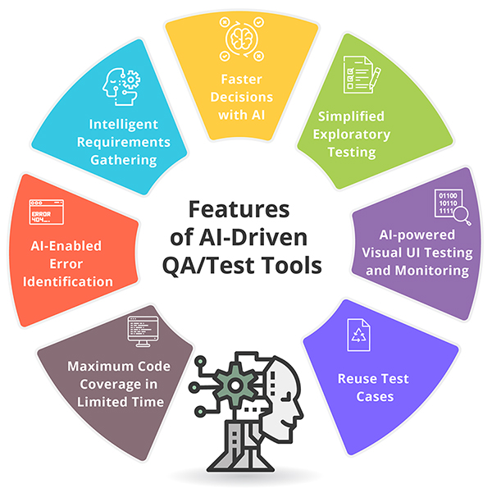
AI and Quality Assurance?
Notes:
Reuse Test Cases The complex process of developing well-written test cases and re-using them for future is made simpler through AI-based test automation tools. AI-based testing tool inspects the application and gathers vital data through screenshots to measure load time, analyze basic UI elements and produce compelling test case suite.
Intelligent Requirement Gathering During requirements gathering, numerous manual functions like reporting, managing the impact of change and tracking approvals, impacts the project deliverables. AI-powered requirement gathering understands the limitations of complex systems and tracks key metrics and KPIs that can be used to predict quality and performance issues proactively.
Simplified Exploratory Testing Testing can be made more effective with fewer resources & codes and maximize the device coverage in minimal time by using the AI-engineered approach. AI identifies scenarios easily through intelligent assistants that capture test data and user performances by steering through an application or system and record default test cases.
AI-Enabled Error Identification Leverage the AI-led QA to unearth defects beforehand, optimize testing and predict failure points, thus reducing the overall cost and achieving high customer satisfaction. Al-enabled performance analysis guarantees security of an application or system by identifying any potential attempts of unauthorized access to the system.
AI-powered Visual UI Testing & Monitoring Artificial Intelligence amplifies test platform with Visual Testing proficiencies to support dev teams release visually perfect web apps with incomparable speed and quality. With the AI-powered monitoring techniques, analyzing outcomes of regression testing is simple, effective and effortless.
Maximum Code Coverage in Limited Time Maximum test coverage is achievable when test plan, test plan, test strategy test cases etc., are planned at an optimum level. The tests could be based on real-time interactions, user flows, keyword, interactions and data-driven approaches. Measuring test coverage with AI-based tools enables the businesses to achieve 100% code coverage.
Faster Decisions with AI AI can get into the depths of data and detect the root cause of issues impacting business performance. It enables analyzing customer data for optimal efficiency, improved innovative capabilities, fine-tune products and services, or better opportunities, hence significantly contributing towards streamlining decisions for better processes.

Slide 6

Benefits of using Gen AI in Software Testing
Notes:
The potential of Generative AI to revolutionize the Quality Assurance (QA) sector is substantial, offering an array of benefits that promise to significantly enhance testing processes. Yet, as with any transformative technology, the journey towards fully leveraging these advantages comes with its unique set of challenges. This calls for a more in-depth examination of the potential rewards and obstacles tied to the integration of Generative AI within QA workflows.

Slide 7
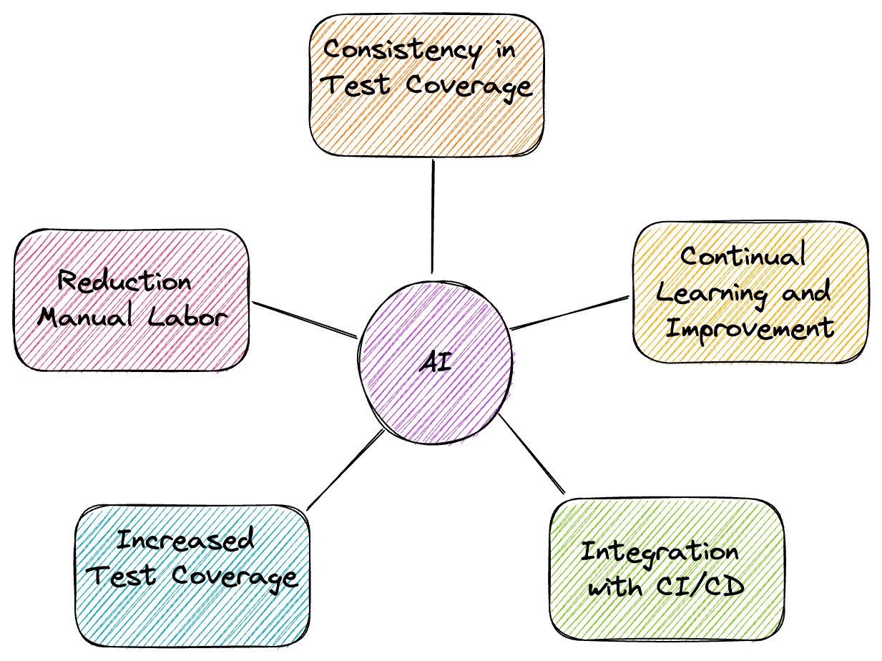
Notes:
Reduction in Manual Labor: A primary advantage of generative AI is its capability to automate the creation of tests, thus reducing the necessity for repetitive manual testing – which is especially beneficial for areas such as regression testing. This automation doesn’t just save valuable time and resources; it also allows QA professionals to focus more on complex tasks that require human intuition and creativity.
Increased Test Coverage: Generative AI can create a wide range of test scenarios, covering more ground than traditional methods. This ability to comprehensively scan the software helps unearth bugs and vulnerabilities that might otherwise slip through, thus increasing the software’s reliability and robustness.
Consistency in Test Quality: Generative AI provides a level of consistency that’s challenging to achieve manually. By leveraging AI, businesses can maintain a high standard of test cases, thereby minimizing human errors often associated with repetitive tasks.
Continual Learning and Improvement: AI models, including generative ones, learn and improve over time. As the AI is exposed to more scenarios, it becomes better at creating tests that accurately reflect the system’s behavior.
Integration with Continuous Integration/Continuous Deployment (CI/CD) pipelines: Generative AI can be a game-changer when it comes to implementing DevOps practices. Its ability to swiftly generate tests makes it a perfect fit for CI/CD pipelines, enhancing the speed and efficiency of software development and delivery.

Slide 8

Challenges of using Gen AI in Software Testing

Slide 9
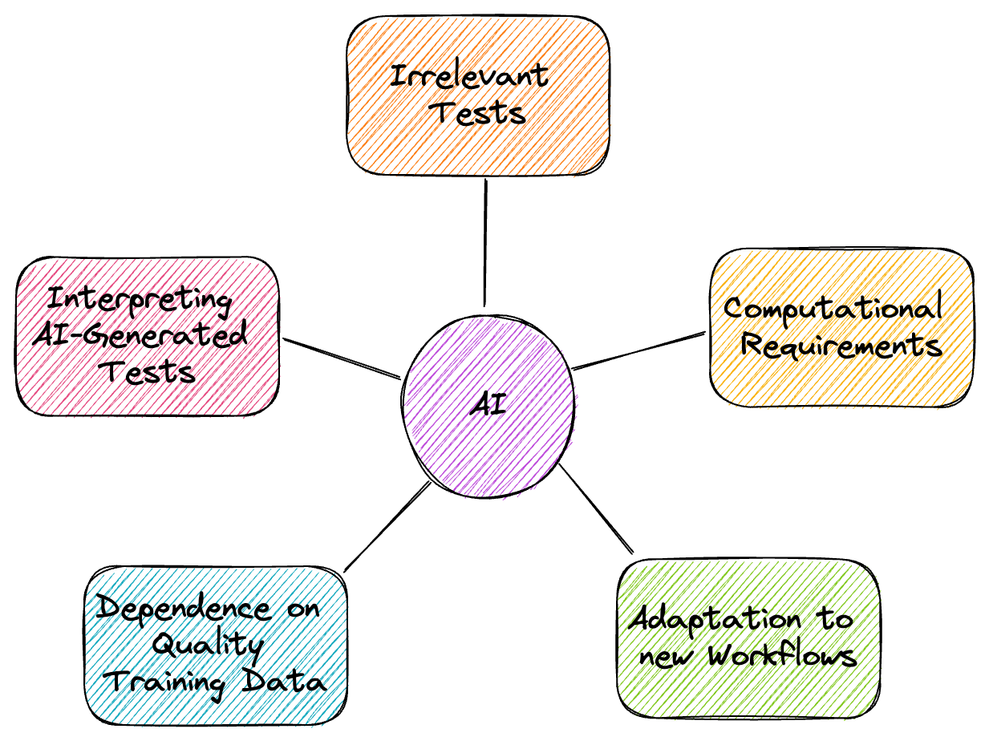
Notes:
Irrelevant Tests: One of the primary challenges is that generative AI may create irrelevant or nonsensical tests, primarily due to its limitations in comprehending context or the intricacies of a complex software system.
Computational Requirements: Generative AI, particularly models like GANs or large Transformers, require substantial computational resources for training and operation. This can be a hurdle, especially for smaller organizations with limited resources.
Adaptation to New Workflows: The integration of generative AI into QA necessitates changes in traditional workflows. Existing teams may require training to effectively utilize AI-based tools, and there could be resistance to such changes.
Dependence on Quality Training Data: The effectiveness of generative AI is heavily dependent on the quality and diversity of the training data. Poor or biased data can result in inaccurate tests, making data collection and management a significant challenge.
Interpreting AI-Generated Tests: While AI can generate tests, understanding and interpreting these tests, especially when they fail, can be challenging. This could necessitate additional tools or skills to decipher the AI’s output effectively.
Navigating these potential obstacles requires a thoughtful approach to integrating Generative AI within QA workflows, along with ongoing adaptation as technology continues to evolve. Despite the challenges, the benefits that Generative AI offers to QA testing are immense, pointing towards a future where the synergy between AI and human testers will create a more robust, efficient, and innovative software testing paradigm.

Slide 10
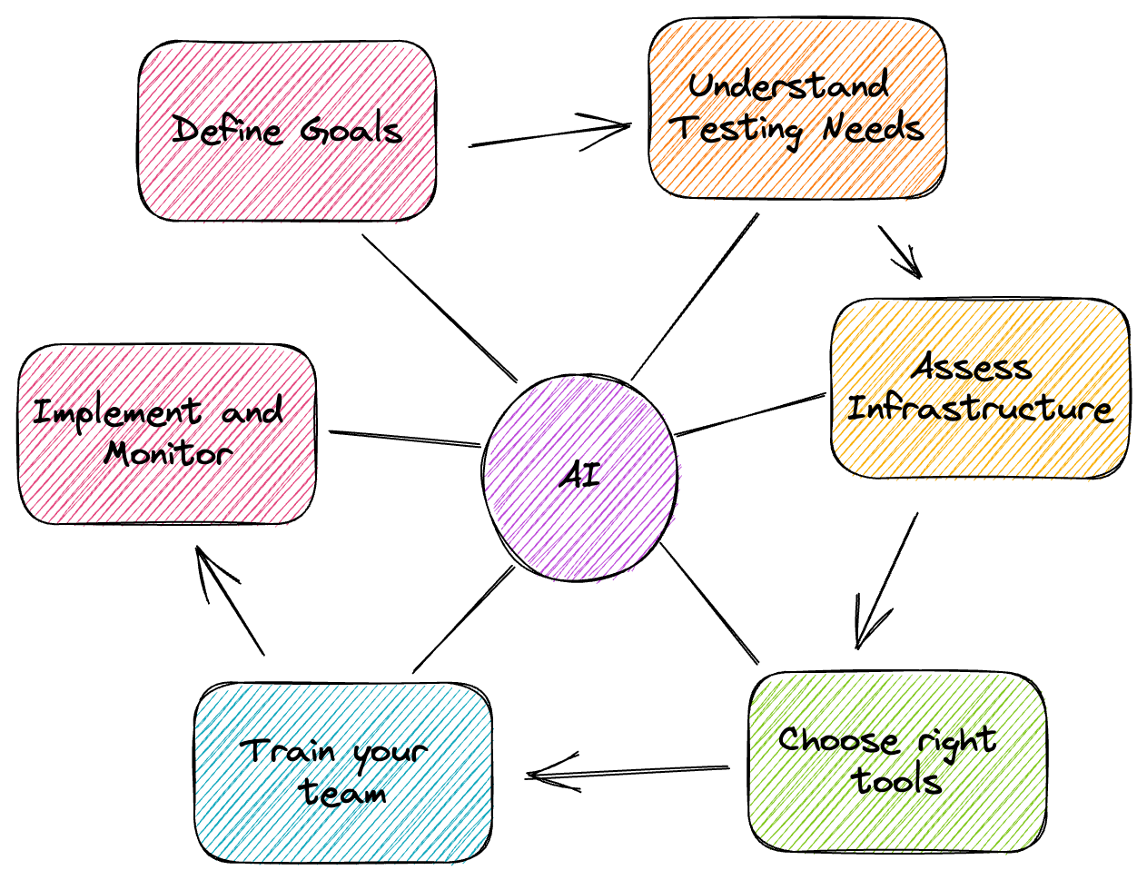
Notes:
Incorporating generative AI into a QA strategy requires careful planning and consideration. Here are some steps that an organization can follow:
Define Your Goals: Start by identifying what you hope to achieve through implementing generative AI in your QA process. This could range from improving test coverage, reducing the time spent on manual testing, enhancing the detection of bugs and vulnerabilities, or a combination of these.
Understand Your Testing Needs: Not all applications or software will benefit from generative AI testing in the same way. Understand the specific needs and challenges of your testing scenario and consider whether generative AI can address them effectively.
Assess Your Infrastructure: Generative AI requires substantial computational resources. Hence, it is necessary to ensure your infrastructure can support these demands. This might mean investing in hardware upgrades or cloud-based solutions.
Choose the Right Tools: There are various generative AI models and tools available, each with its own strengths and weaknesses. Evaluate these options in terms of your defined goals and testing needs to select the most suitable ones.
Train Your Team: Implementing generative AI in QA will require your team to have the necessary skills to work with AI systems effectively. This might involve training in AI fundamentals, how to interpret AI-generated test results, and how to troubleshoot potential issues.
Implement and Monitor: Once you have defined your goals, understood your testing needs, assessed your infrastructure, chosen the right tools, and trained your team, it is time to implement the strategy. Begin by introducing AI in a few key areas and gradually expanding its use. Regularly monitor and review the performance of the AI in your testing process to ensure it is meeting your goals.

Slide 11

Scan me please!!!

Slide 12


Gen AI Code Completion in React

Slide 13

GitHub Copilot in React
Open chat and type
//Write tests for EmojiPickerButton.js
using react-native-testing-library
Notes:
Let’s see how Copilot can help with writing tests for React Native components. For that purpose, we will use the React Native component from Expensify's app repository which is called EmojiPickerButton

Slide 14
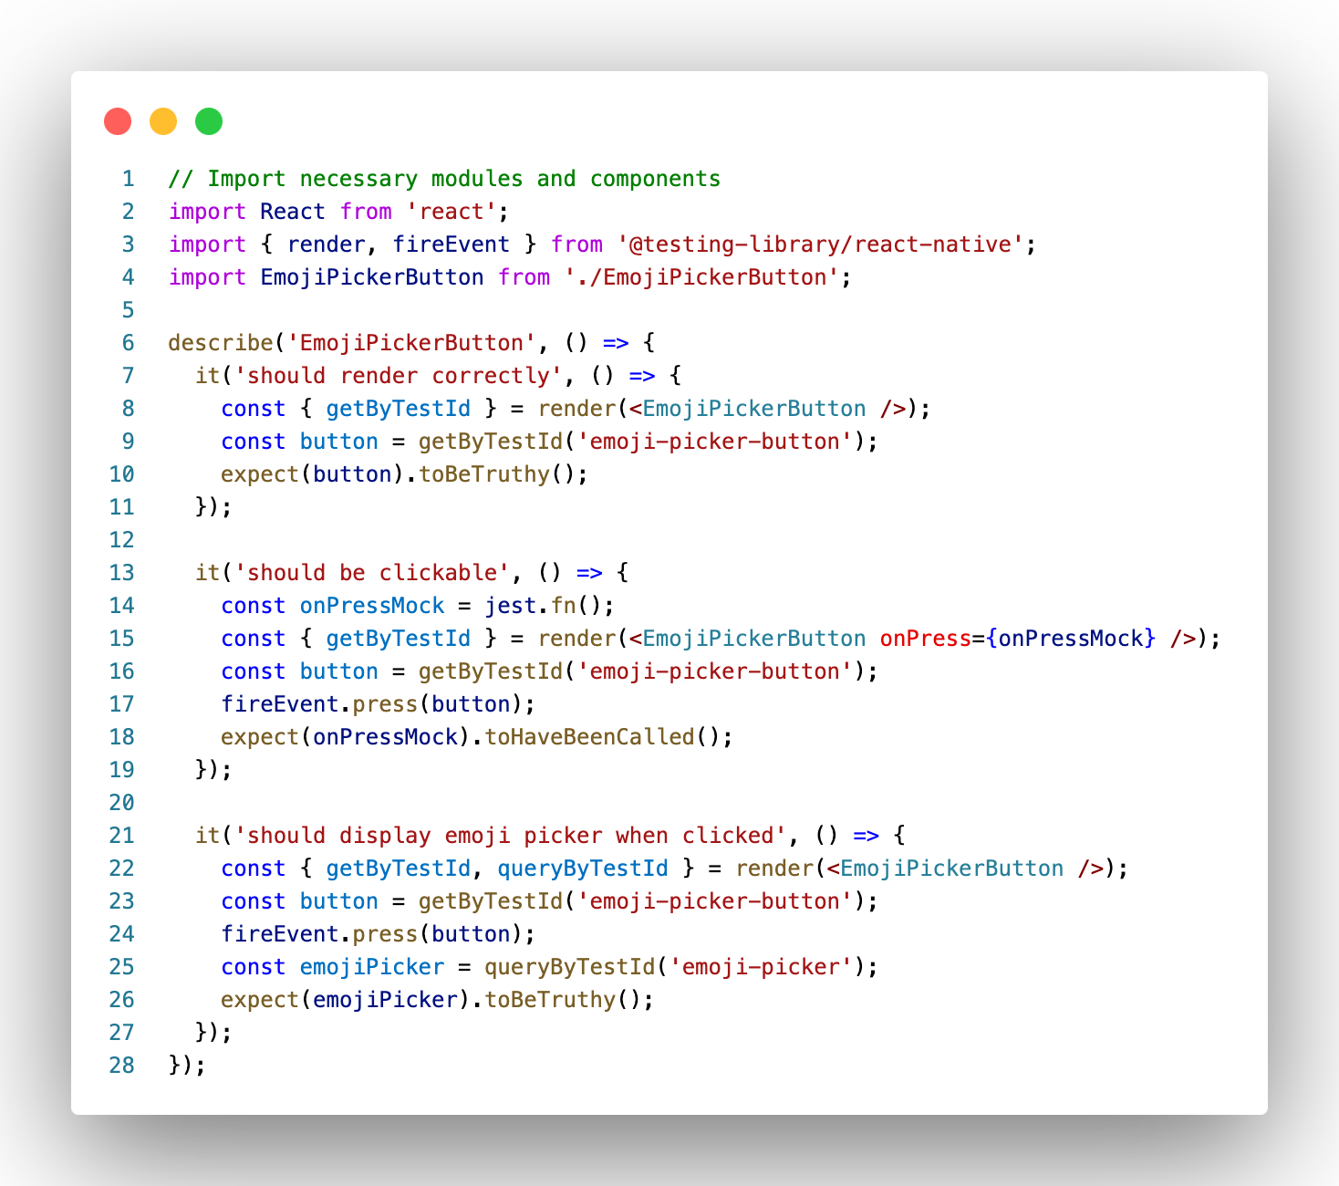
GitHub Copilot in React
At first glance, it looks pretty good!
Check if our component renders correctly
Check if it calls the onPress property when it's pressed, a basic button test.
Check if emoji picker is displayed

Slide 15
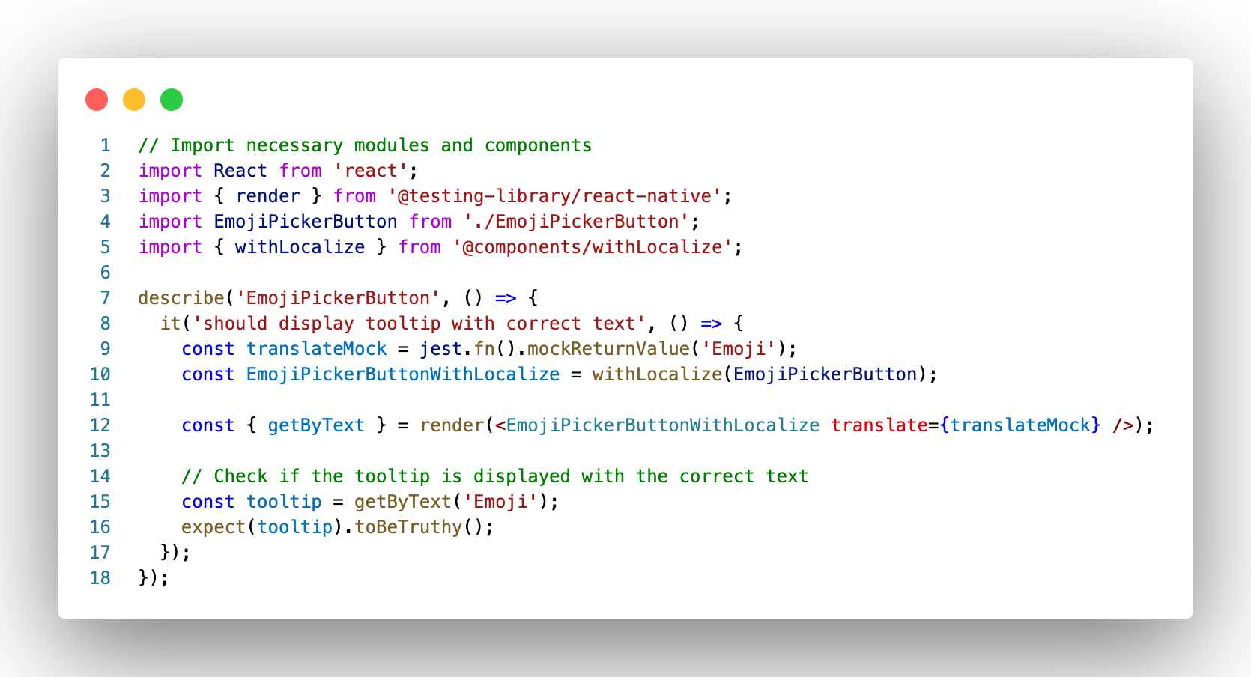
GitHub Copilot in React with human guidance
Let’s add one more test that checks if tooltip is shown with text
Notice how we shifted our focus from figuring out the implementation, to finding a better test description and defining our expectations clearly. Pretty neat, huh?
Notes:
write a test for showing toolkit

Slide 16

Gen AI Code Completion in React
Notes:
Generative Pre-trained Transformers (GPTs) are a family of neural language models that use the transformer architecture to generate coherent text in a human-like manner. GPTs are trained on large amounts of text data using unsupervised learning techniques, such as self-supervised learning, which allows them to learn patterns and relationships in language without explicit supervision.

Slide 17
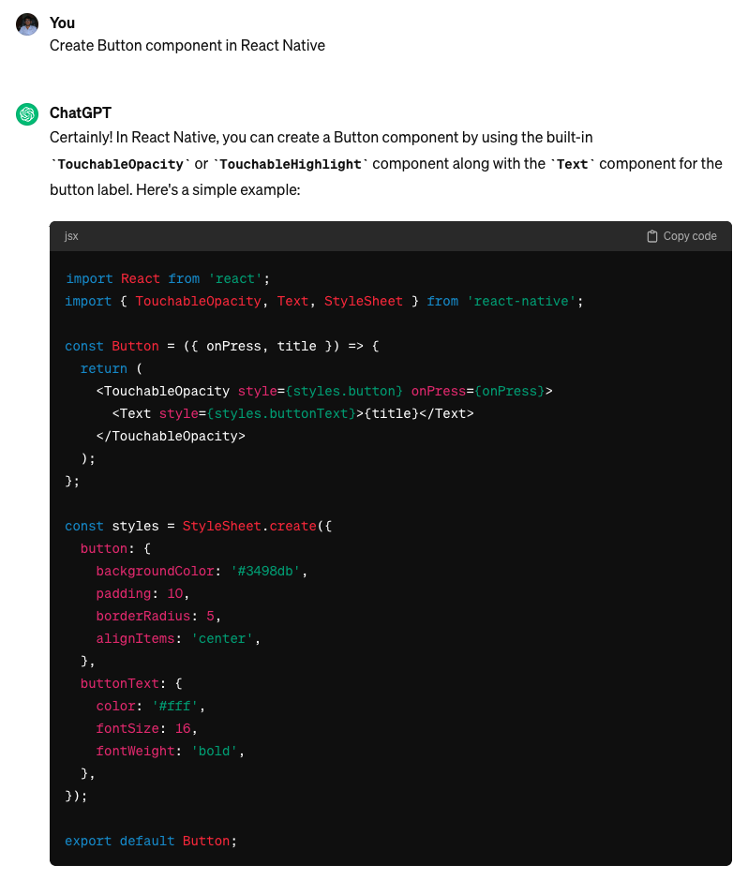
Generative Pre-Trained Transformers
The easiest way to use one is to use ChatGPT by OpenAI, web application powered by GPT-3.5, which is an improved version of the GPT-3 model with additional training data and parameters

Slide 18
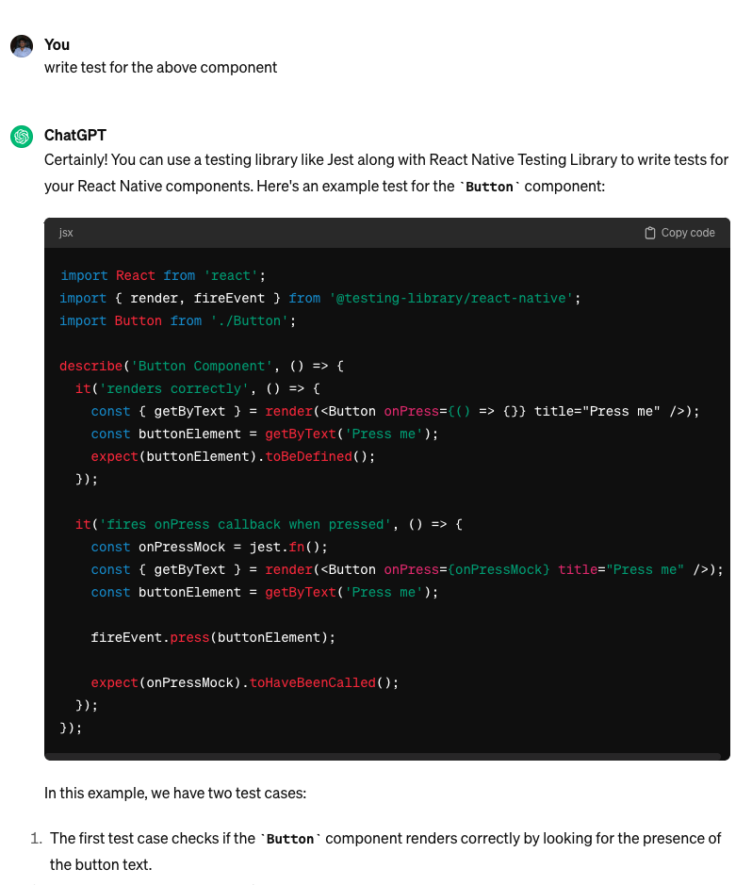
Generative Pre-Trained Transformers
And then you can simply ask it to generate tests for the above component
Without specifying, it used react-native-testing-library and covered the rendering component and checked if onPress props were called on button press.

Slide 19
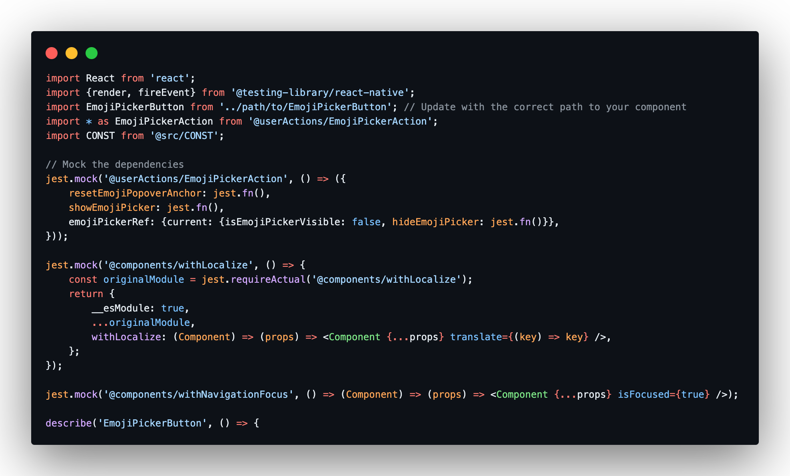
Generative Pre-Trained Transformers
Let’s use ChatGPT for the same example we did for GitHub Copilot - EmojiPickerButton.
To do that, we need to copy the whole implementation of EmojiPickerButton and paste it to ChatGPT!!!
Notes:
It is immediately noticeable that ChatGPT generated better tests for our component than Copilot without any additional guidance. It correctly recognized that EmojiPickerButton accepts onModalHide, onEmojiSelected and isDisabled props. But also made the same mistake as Copilot and tried to check if mocked functions passed into these props had been called. It’s also missing withLocalize HOC mock. You may notice that it wants to use emoji-picker-button test ID (same as Copilot), which may seem incorrect, because it’s missing in original component implementation, but ChatGPT added note that it’s necessary to add testID prop to Pressable component:
Note that you will need to add a testID prop to the Pressable component in the EmojiPickerButton component in order to use getByTestId in the tests.
ChatGPT was able to generate more accurate tests for the EmojiPickerButton component without any additional guidance (except for missing withLocalize HOC mock). It correctly identified the props that the component accepts and mocked up the required functions. It also provided an updated version of the component with the testID property implemented. Unfortunately, it created one test that incorrectly checks if mocked functions are called.
Keep in mind that results obtained for a given prompt from ChatGPT may be different every time they are generated.

Slide 20
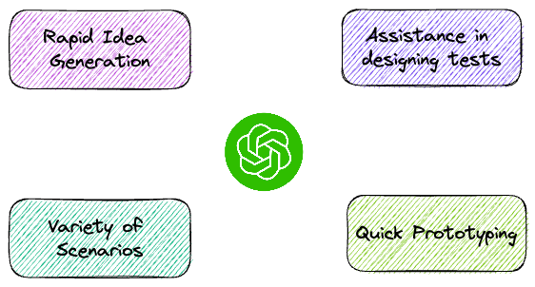
Advantages of using ChatGPT
Notes:
Rapid Idea Generation: ChatGPT can quickly provide ideas for test cases, especially for complex scenarios or edge cases that might be overlooked.
Variety of Scenarios: ChatGPT can help generate a wide range of test cases, covering different aspects of the application, improving test coverage. It might come up with things you would not have considered.
Assistance in designing tests: It can assist in formulating test scenarios and designing test cases that are well-structured and cover relevant functionalities.
Quick Prototyping: ChatGPT can be useful for quickly prototyping test cases during initial development phases or for exploratory testing. You can then refine the test scenarios manually to your liking.

Slide 21
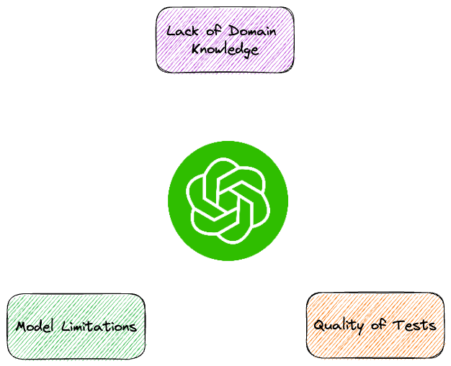
Disadvantages of using ChatGPT
Notes:
Lack of Domain Knowledge: ChatGPT might lack specific domain knowledge or context about the application being tested, leading to inaccurate or irrelevant test case suggestions.
Quality of Tests: The generated test cases might not follow established testing standards, leading to inconsistent or insufficient test coverage.
Model Limitations: ChatGPT might sometimes produce inaccurate suggestions, which could negatively impact the quality of generated test cases.

Slide 22

Traditional ML in Selenium

Slide 23
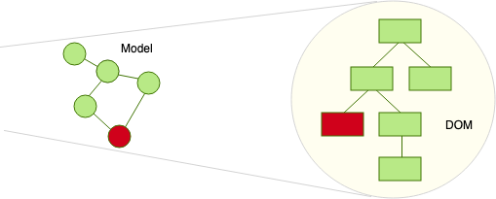

Case Study
Functional tests tend to fail when engineers make any changes to the DOM like changing the element attributes
Notes:
We will build a Selenium bot in Python that self heal changes in the DOM on GWI Login Page using Machine Learning and AI techniques. We will scrape data from login page and use ML to determine a self healing mechanism when DOM elements are changing attributes in UI.

Slide 24
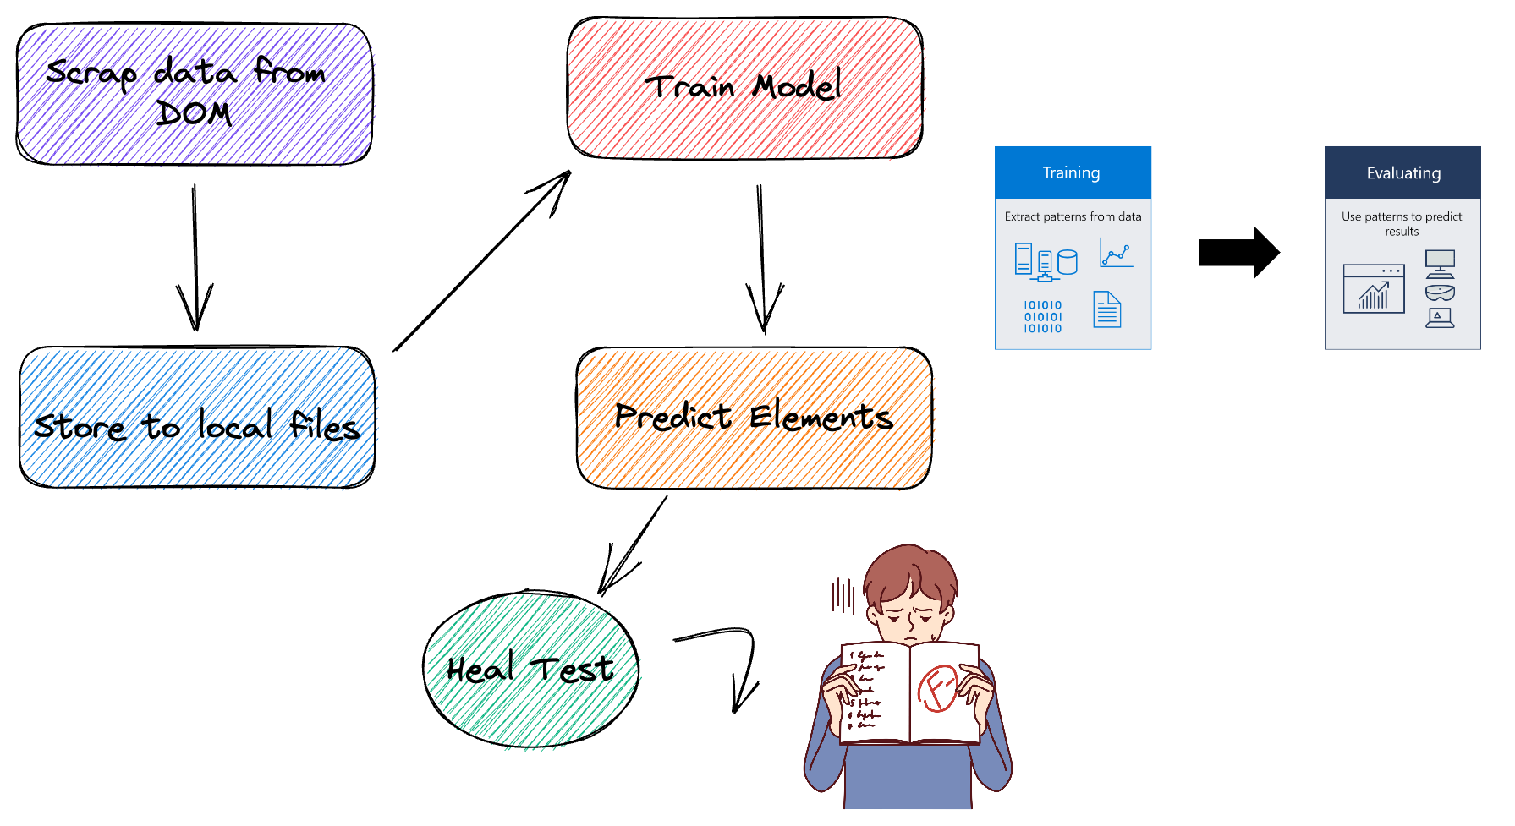
Concept

Slide 25

Dependencies

Slide 26

ML Dependencies
Pandas is a Python package that provides fast, flexible, and expressive data structures designed to make working with "relational" or "labeled" data both easy and intuitive. It aims to be the fundamental high-level building block for doing practical, real world data analysis in Python.
Execute: pip install pandas

Slide 27

ML Dependencies
Scikit-learn is an open source machine learning library that supports supervised and unsupervised learning. It also provides various tools for model fitting, data preprocessing, model selection, model evaluation, and many other utilities.
Execute: pip install -U scikit-learn

Slide 28

ML Dependencies
NumPy is a Python library used for working with arrays.
It also has functions for working in domain of linear algebra, fourier transform, and matrices.
Execute: pip install numpy

Slide 29
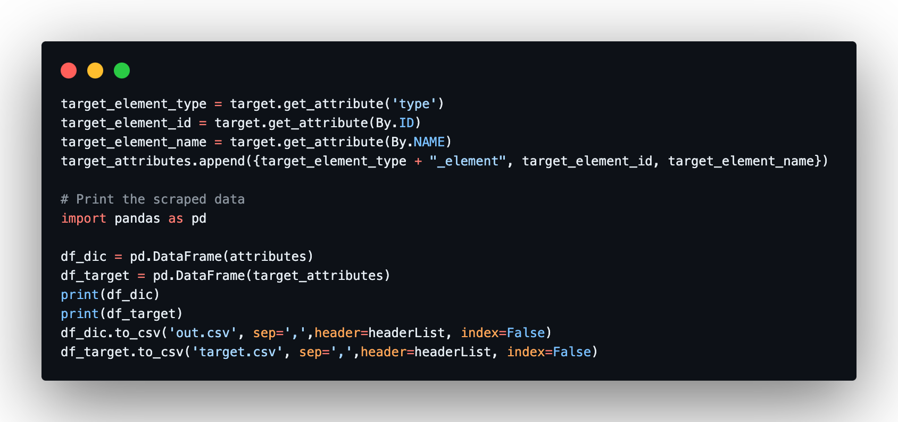

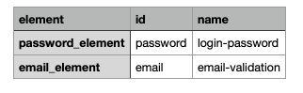
Step 1: Scrape Data from DOM
We will scrape data using selenium from the page and store them in CSV
Element tags

Slide 30
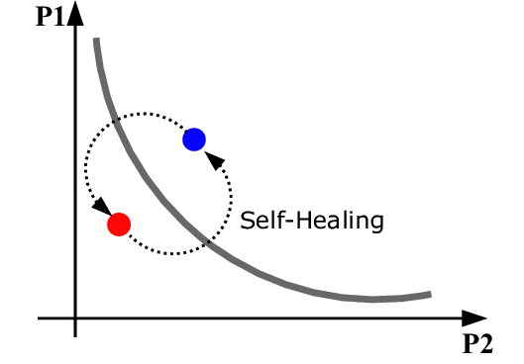
Step 2: Self Healing
Self Healing comes into play when the DOM is changed(change on the attribute used), thus tests needs to detect the correct element based on its other attributes.
Here ML comes into the picture
We need to train the model to get the correct probability of the element
Training shall require two datasets

Slide 31
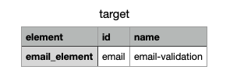
Step 2: Self Healing
Training data set — All the relevant attributes on the current page
Test data set — All the attributes for the current element
Target HTML Element

Slide 32
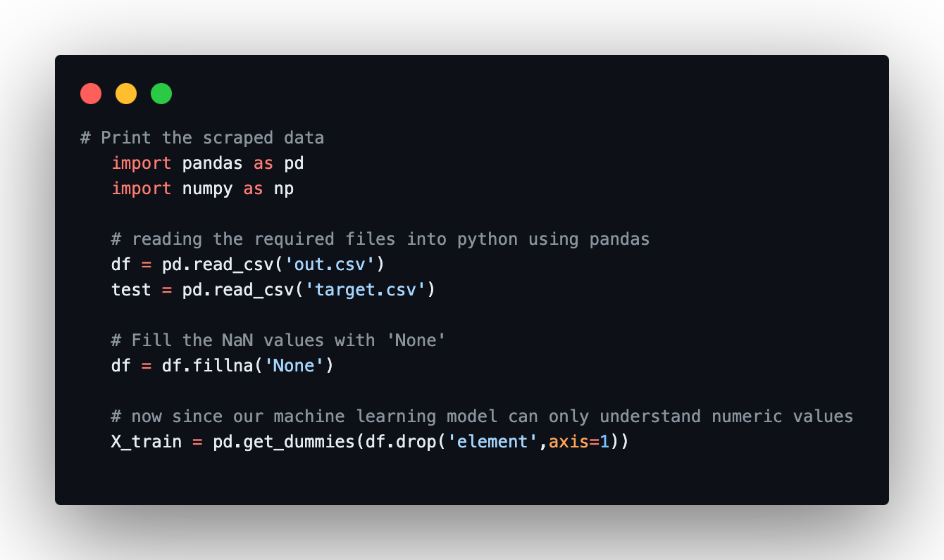
Step 3: Model Training
Read the data from the local files fill NaN values and convert them into dummy/indicator variables
Notes:
X_train - This includes your all independent variables, these will be used to train the model

Slide 33
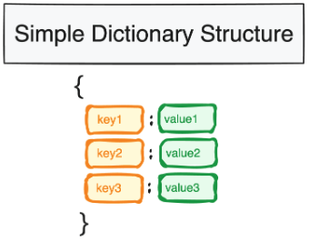
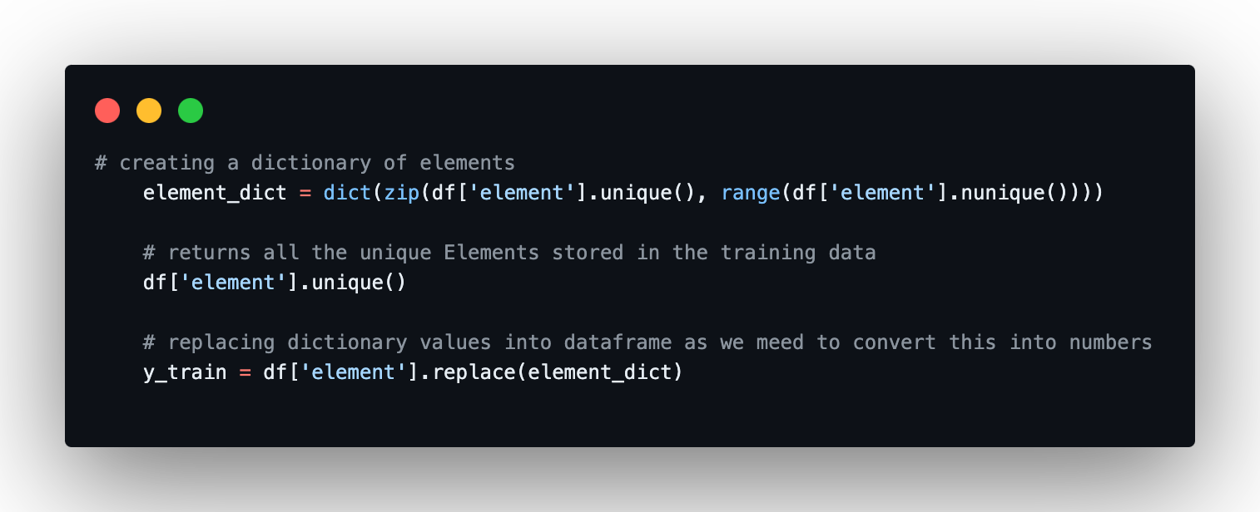
Step 3: Model Training
Map of all the elements in page that can be used for y_train
Notes:
A dictionary in Python is a collection that is both unordered and mutable, designed to store data values like a map.
Y_train: This is your dependent variable which needs to be predicted by this model, this includes category labels against your independent variables, we need to specify our dependent variable while training/fitting the model.

Slide 34
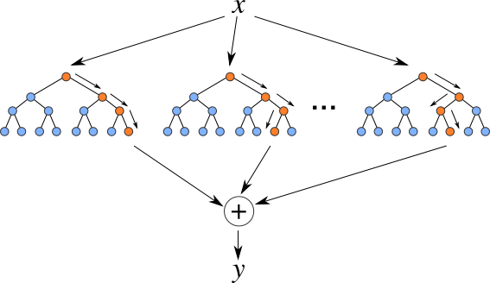
Step 3: Model Training
Now we need to train the model!
We used Random Forest Classifier for this
Notes:
Random Forest algorithm is a great choice for anyone who needs to develop a model quickly. Random forests are also very hard to beat performance wise. It can handle a lot of different feature types, like binary, categorical and numerical. Overall, random forest is a simple and flexible tool that being said any model will have its own limitations.

Slide 35
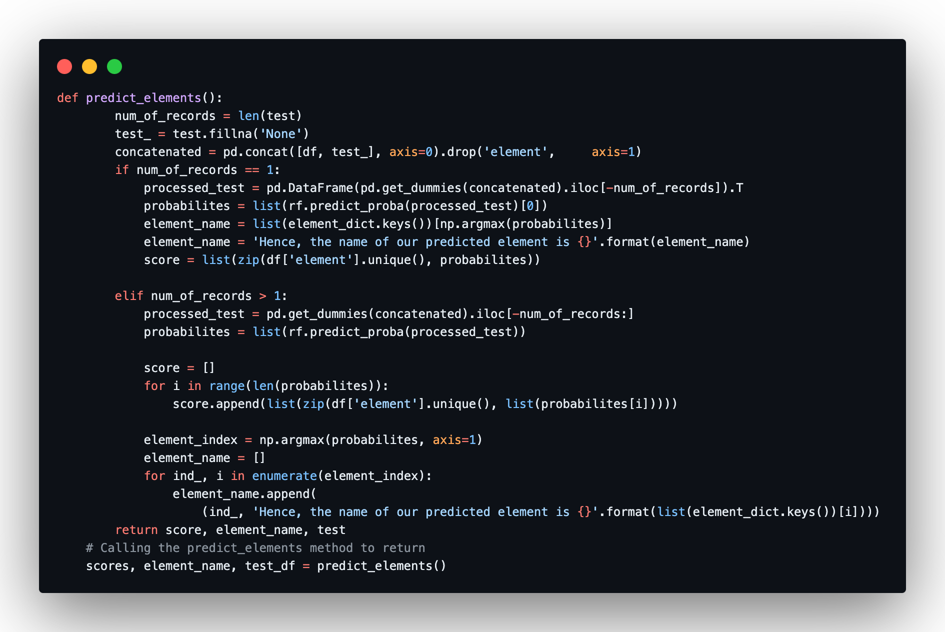
Step 4: Predict Elements

Slide 36
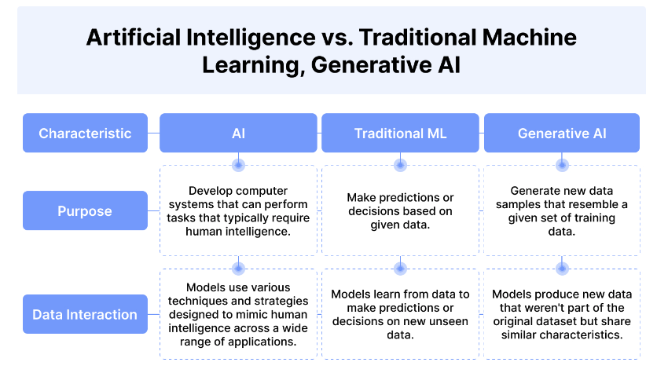
Comparative Analysis
Notes:
Essentially, the relationship between artificial intelligence and generative AI is hierarchical.
AI refers to the development of computer systems that can perform tasks that previously required human intelligence.
Machine learning is a subset of AI that focuses on discriminative tasks. It involves the development of algorithms that enable computers to make predictions or decisions based on data without being explicitly programmed how to do so.
Generative AI is a subset of machine learning (ML) that focuses on creating new data samples that resemble real-world data.
Traditional AI involves rules-based machine learning algorithms trained on a single data type to perform a single task.
In contrast, generative AI uses deep learning (DL) strategies capable of learning from diverse datasets and producing outputs that fall within an acceptable range. This flexibility allows the same foundation model to be used for various tasks. For example, ChatGPT can now process image and text prompts.

Slide 37
Conclusion
Benefits of Gen AI in Software Testing:
Automated Testing
Code generation and Review
Predictive Analytics
Bug Detection and Resolution
Continuous Integration and Deployment CI/CD
Test Data Generation

Slide 38
Thank you!
Questions?
Email gpapadakis@gwi.com
Social LinkedIn

